Slide 1



Hostel Management System – WebApp
BY:
MADHANKUMAR C 23CDR082
KARTHIKRAJA S 23CDR069
POORNACHANDRAN NC 23CDR120
Review 3 – 26/4/25

Slide 2
Problem Description
Hostel management is typically handled through manual registers and spreadsheets.
This leads to inefficiencies, data loss, and human errors.
There is no centralized system to track room allocation, maintenance, student attendance, or fee payments.
A digitized solution is necessary.

Slide 3
Objectives
To develop a centralized digital platform for managing hostel operations
To enable smooth room allocation, fee tracking, and student information management
To reduce dependency on manual paperwork and improve accuracy
To create separate access for admin and students with relevant privileges
3

Slide 4
Existing System Limitations
Manual data entry in books or Excel files
No easy search, filter, or update functionality
Time-consuming processes for handling room availability and student complaints
Poor visibility for students to access their own records
4

Slide 5
Proposed Solution Overview
A Web-based Hostel Management System developed using Flask and MySQL,
Admin dashboard to manage students, rooms, and payments
Student dashboard to view their own room details, attendance, and payment history
Maintenance tracking and automated data storage

Slide 6
Technologies Used
Frontend: HTML, CSS (Jinja2 templating)
Backend: Python (Flask Framework)
Database: MySQL using XAMPP
Version Control: GitHub
Server: Localhost (XAMPP for MySQL, Flask for app routing)

Slide 7
Completed Features Summary
Role-based login system
Full CRUD operations for student and room management
Attendance tracking and display
Maintenance request submission and management
Fee payment logs for admin and student reference

Slide 8
Deployment Setup
Hosted on localhost via Flask’s built-in server
MySQL database running on XAMPP
App starts from app.py
DB created using create_mysql_db Python file

Slide 9
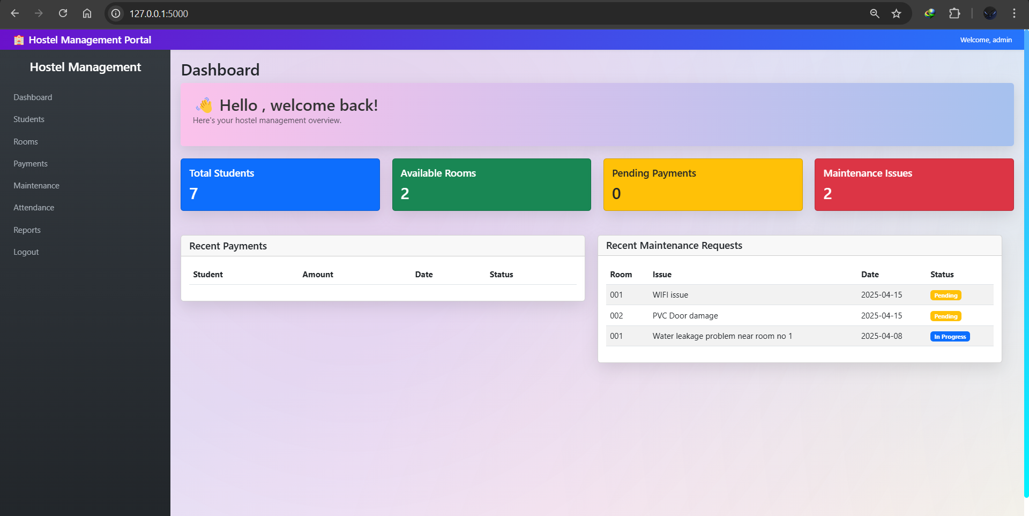
Admin Dashboard

Slide 10
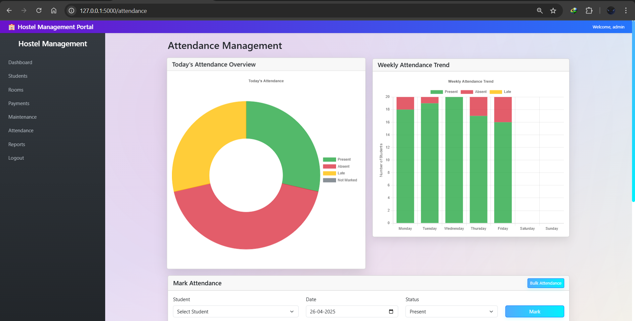
Admin Attendance Panel

Slide 11
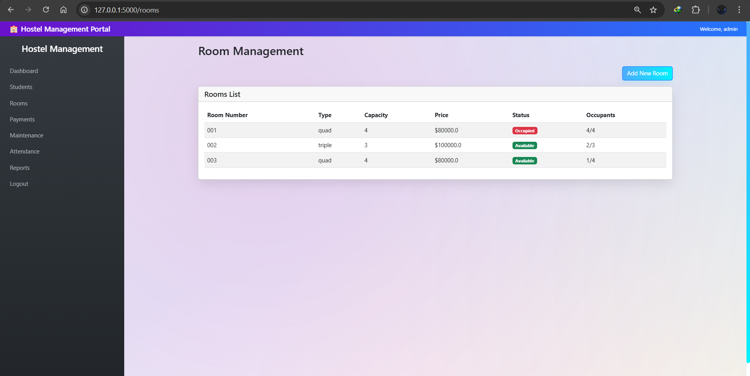
Room Allocation Panel

Slide 12
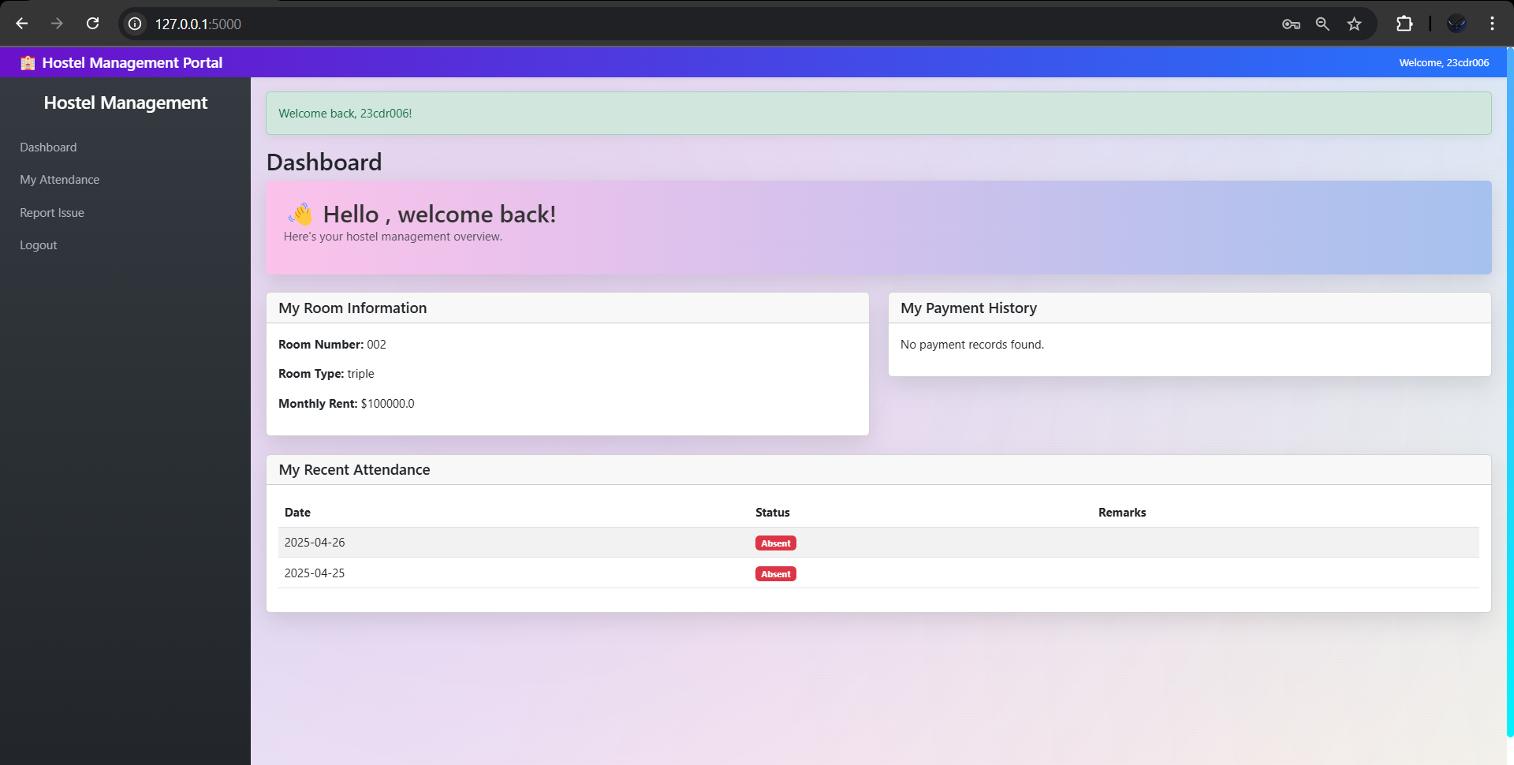
Student Dashboard

Slide 13
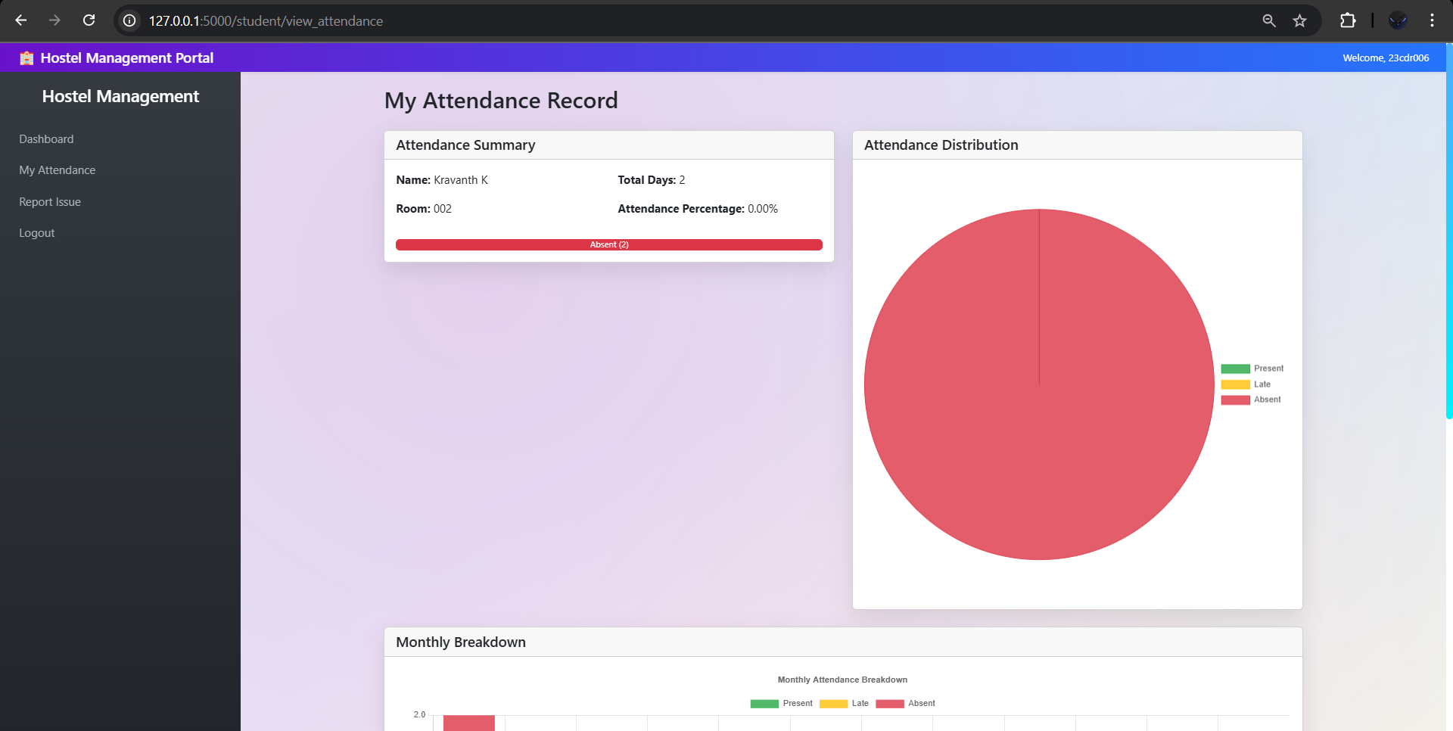
Student Attendance Panel

Slide 14
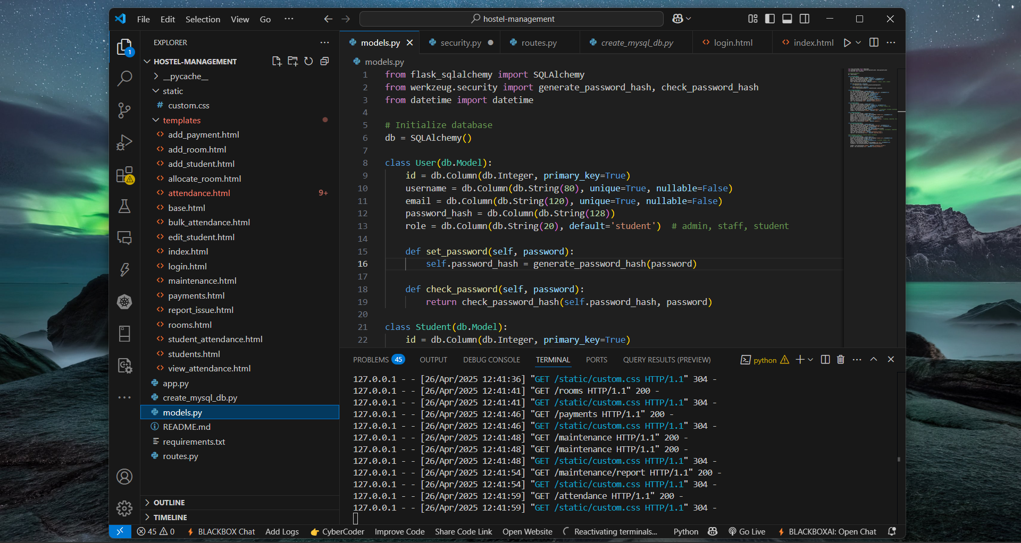
Initialization of DB

Slide 15
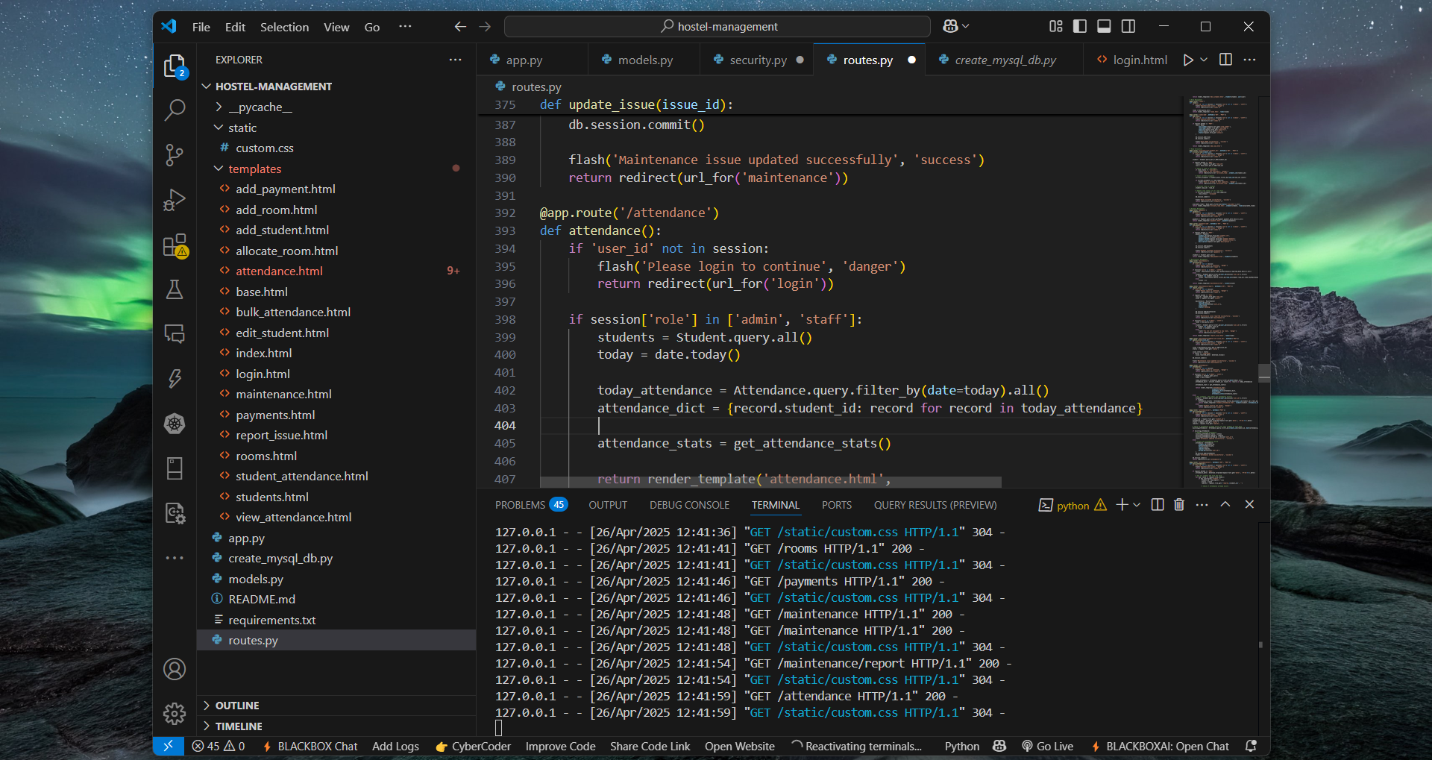
Dashboard Backend

Slide 16
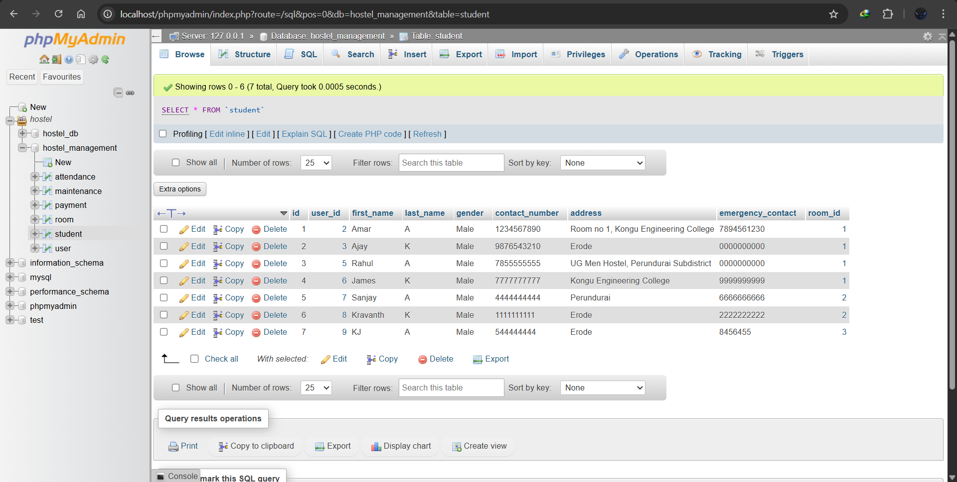
DataBase in XAMPP

Slide 17
Future Scope & Enhancements
Integrate Razor pay or UPI for online payments
Auto-alerts via email/SMS for fee reminders
Mobile app version using React Native or Flutter

Slide 18
Thank you!

